Slide 1


Data Sharing
Data Management Workshop
May 2nd , 2017
Gatineau, Quebec

Slide 2

Where a majority of data end up now…
Notes:
There is an abundance of data and metadata (if it is done) that end up in filing cabinets, on discarded hard drives, in hard-copy journals on the library shelves (or on the web), but many are subscription-only journals.

Slide 3
Imagine if data were more accessible….
Notes:
Data should be properly managed and eventually be placed where they are accessible, understandable, and re-usable.

Slide 4
Open Access and Publically Accessible Data
Increases the impact and visibility of research
Promotes innovation and potential new data uses
Leads to new collaborations between data users and creators
Maximizes transparency and accountability
Encourages improvement and validation of research methods
Reduces cost of duplicating data collection
Provides important resources for education and training
NSERC requirements
Notes:
UK Data Archive: http://www.data-archive.ac.uk/

Slide 5
Data Sharing Stages
document the data content, character and process with metadata
Describe
store the data in a location from which it can be accessed
Deposit
select storage formats and media with long term use in mind
Preserve
publish information about the data so that others can find it
Discover
Notes:
Effective data sharing requires careful thought during each stage of the data development process including:
description and documentation of the data process, content, and character;
deposition and storage of the data in a location from which it can be accessed or shared;
preservation of the data using a format and media that enable long term reuse; and
making the data discoverable by publishing information about the data in research publications, data clearinghouses and data distribution portals.

Slide 6






Data Sharing
All research data should be preserved in a publicly accessible, secure and curated repository for discovery and reuse by others.
Dryad
Figshare
Biodiversity Data Journal
OBIS
GitHub
Zenodo

Slide 7

Copyrights
Why use an open license?
Facilitate data sharing and discovery
Increase visibility of your data
Advance science and public knowledge
Creative Commons Licenses:
CC0 (not a license, but a waiver)
CC BY (Attribution)
CC BY-ND (Attribution-NoDerivs)
CC BY-NC (Attribution-NonCommercial)
CC BY-SA (Attribution-ShareAlike)
Others:
Open Data Commons Open Database License (ODbL)
MIT License (for Software)

Slide 8
Acknowledgements
All users of research data should acknowledge, through citation and any other practices or standards relevant to their discipline(s), the source(s) of the data they are using and respect the terms and conditions under which these data were accessed.
We recommend the following acknowledgement when presenting your CHONe research:
“This research is sponsored by the NSERC Canadian Healthy Oceans Network and its Partners: Department of Fisheries and Oceans Canada and INREST (representing the Port of Sept-Îles and City of Sept-Îles). (NETGP 468437-14, CHONe Project #.#.#)”

Slide 9
Concerns About Data Sharing
Concern | Solution
inappropriate use due to misunderstanding of research purpose or parameters
security and confidentiality of sensitive data
lack of acknowledgement / credit
loss of advantage when competing for research dollars
Notes:
⁸ Niu, J. (2006). Reward and Punishment Mechanisms for Research Data Sharing. IASSIST Quarterly, Winter 2006.
¹Guide to social science data preparation and archiving: Best practice throughout the data life cycle, 4th edition (ICPSR, 2009)
⁹Borgman, C.L. Research Data: Who will share what, with whom, when, and why? In Proceedings of the China-North American Library Conference, Beijing , September 2010. (http://works.bepress.com/borgman/238/)

Slide 10

Concerns About Data Sharing
Concern | Solution
inappropriate use due to misunderstanding of research purpose or parameters
security and confidentiality of sensitive data
lack of acknowledgement / credit
loss of advantage when competing for research dollars
metadata
metadata
metadata
metadata
Notes:
Each of these issues can, in great part, be addressed by providing rich data documentation known as ‘metadata’.

Slide 11
Concerns About Data Sharing
Concern | Solution
inappropriate use due to misunderstanding of research purpose or parameters | Abstract, Purpose, Attributes, Methods and Supplemental Information where needed
security and confidentiality of sensitive data | the metadata does NOT contain the data Use Constraints specify who may access the data and how
lack of acknowledgement / credit | specify a required data citation within the Use Constraints
loss data insight and competitive advantage when applying for research grants | Open access and data discoverability to promote research
Notes:
By providing metadata, the research scientist establishes the purpose, methods, sources and parameters of the data. As such, data users are given the information necessary to appropriately apply, protect and cite the data. If the metadata contains information about proprietary data processing or analysis techniques, the competitive advantage can be maintained by creating a second, more generalized, metadata record for public distribution.

Slide 12
Concerns About Data Sharing
Privacy laws
Sensitive data protection
Respect of traditional knowledge
Intellectual property laws

Slide 13

Solution!
Privacy:
Institutional ethics review processes
e.g. Research Ethics Boards
The rights and privacy of individuals who participate in research must be protected at all times.
Data made available for broader use should be free of identifiers.
e.g. anonymization/de-personalization of data.
Name | ID
Angela Grant | 1
Megan Bailey | 2
Lucia Fanning | 3
Tri-Council Policy Statement on the Ethical Conduct for Research Involving Humans, 2014

Slide 14
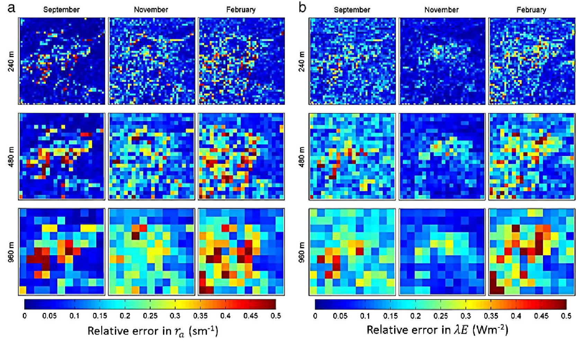
Solution!
Abundance of Wolf Fish:
Sensitive data:
i.e. Location of endangered species or harvest data
“data can be embargoed for a determined period of time or where possible, spatial and temporal data aggregation methods, e.g., the classification of fisheries data into a multi-class range (e.g., quantiles, equal interval breaks) may be applied to ensure protection of information prior to being shared publicly.”
2m
20m
50m

Slide 15
Solution!
Traditional Knowledge:
“In the context of research involving Indigenous knowledge, data management principles based on the concepts of respect, reciprocity, and responsibility should be observed. This includes appropriate engagement of Indigenous people, communities or organizations throughout the entire data lifecycle, formal attribution of contributed knowledge, establishment of informed consent for use of knowledge and derived products, and the maintenance of contributor control of data and information resources. Required institutional ethics review processes (i.e. Research Ethics Boards) will guide data management, however Indigenous communities or organizations may have specific practices or requirements in place. It is the responsibility of researchers to familiarize themselves with and adhere to these practices and requirements.”
The International Arctic Science Committee (IASC)

Slide 16

Solution!
Intellectual Property:
“It may be necessary to delay sharing research data for a period of time, in cases whereby institutions or researchers are applying for patents or developing new applications based on that data.”

Slide 17
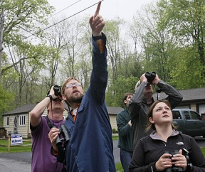
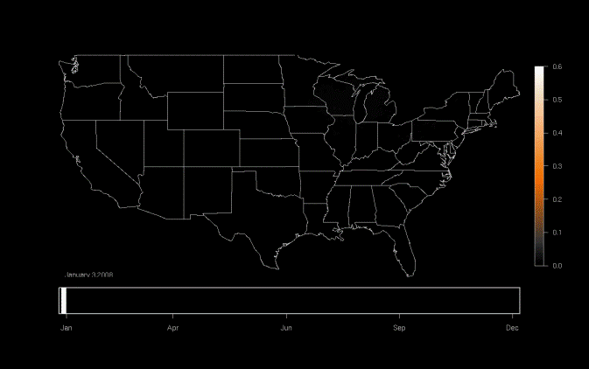
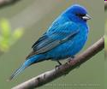
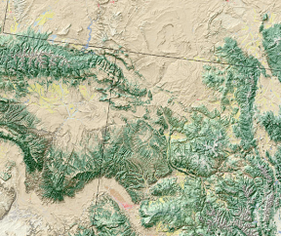
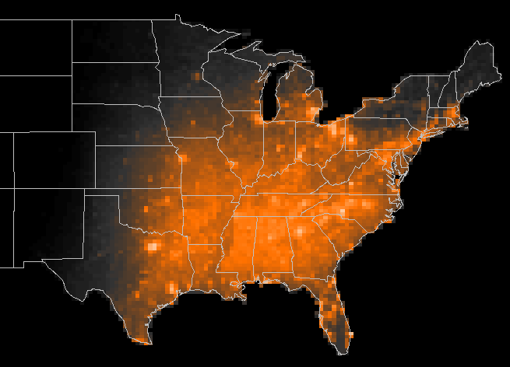


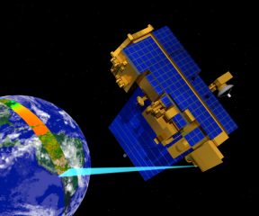
Well-Managed Data Can Result in Re-use, Integration, and New Science
Model results
Bird Observations
Occurrence of Indigo Bunting
Model: Indigo Bunting locations during the year
Land Cover
Jan
Apr
Jun
Sep
Dec
Meteorology
Potential Uses-
Examine patterns of migration
Infer impacts of climate change
Measure patterns of habitat usage
Measure population trends
MODIS – Remote sensing data
Slide courtesy of DataOne
Notes:
By re-using data collected from a variety of sources – eBird database, land cover data, meteorology, and remotely sensed by NASA – this project was able to compile and process the data using supercomputering to determine bird migration routes for particular species.

Slide 18
Network Deliverables
Journal publications
Technical/policy reports
Books
Theses
Educational documents
Technical/analytical frameworks
New statistical/analytical techniques
Maps (pdf, raster, shapefiles..)
Models
Code (R, Python..)
Spreadsheets
Samples
Specimens
Video, Audio and Photos
Partnership meetings
Posters
Presentations
Public forums
Podcasts, blogs and videos
Participation in workshops and conferences and dicussions
Uptake of research by private enterprise
Contribution to management and policy decisions
Interviews with radio, tv or newspapers

Slide 19
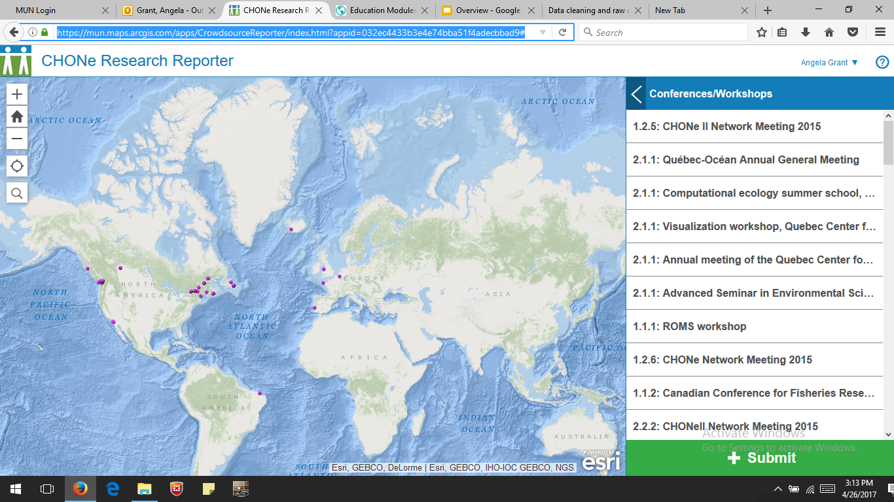
CHONe Research Reporter
https://mun.maps.arcgis.com/apps/CrowdsourceReporter/index.html?appid=032ec4433b3e4e74bba51f4adecbbad9#

